Slide 1
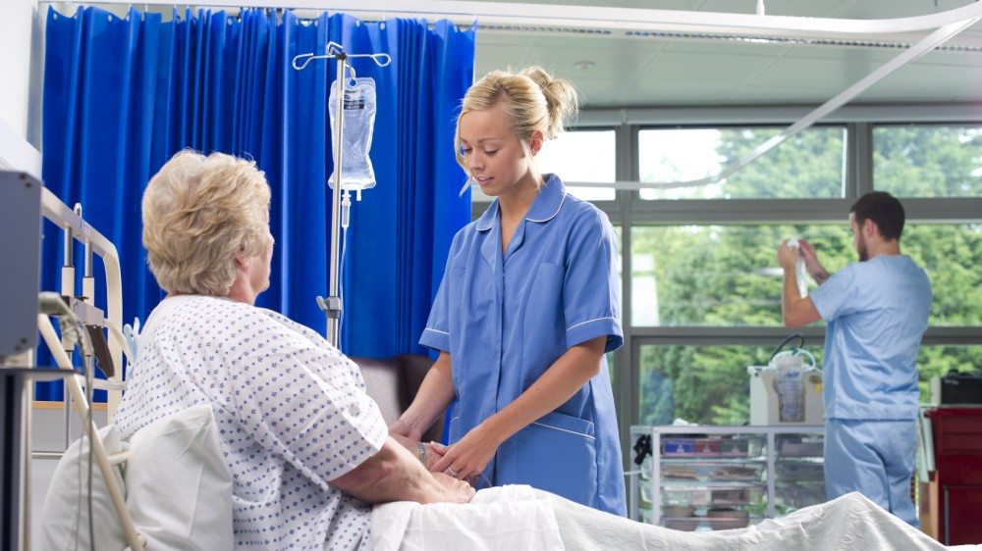
شغل ها
پرستار
فردی که بطور رسمی تحصیل کرده و اموزش دیده تا از بیماران مراقبت کند .
This Photo by Unknown Author is licensed under CC BY-ND

Slide 2
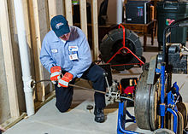
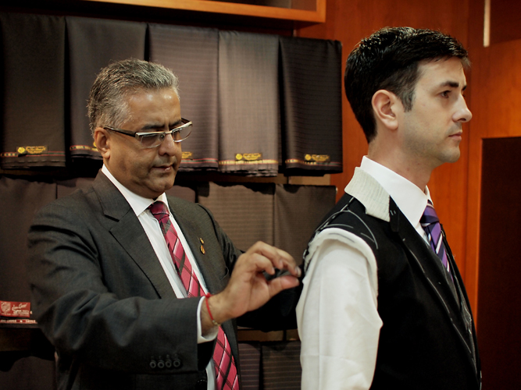
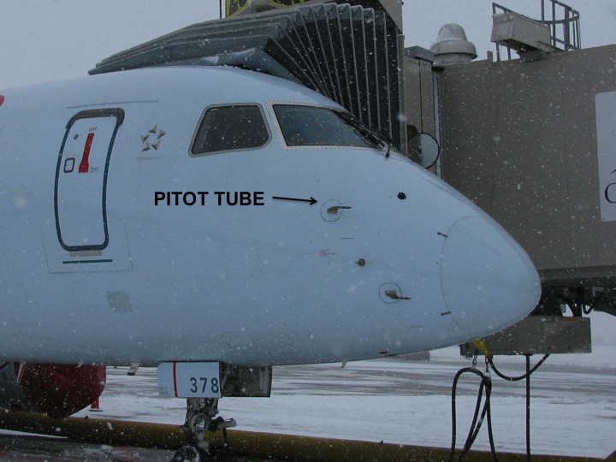
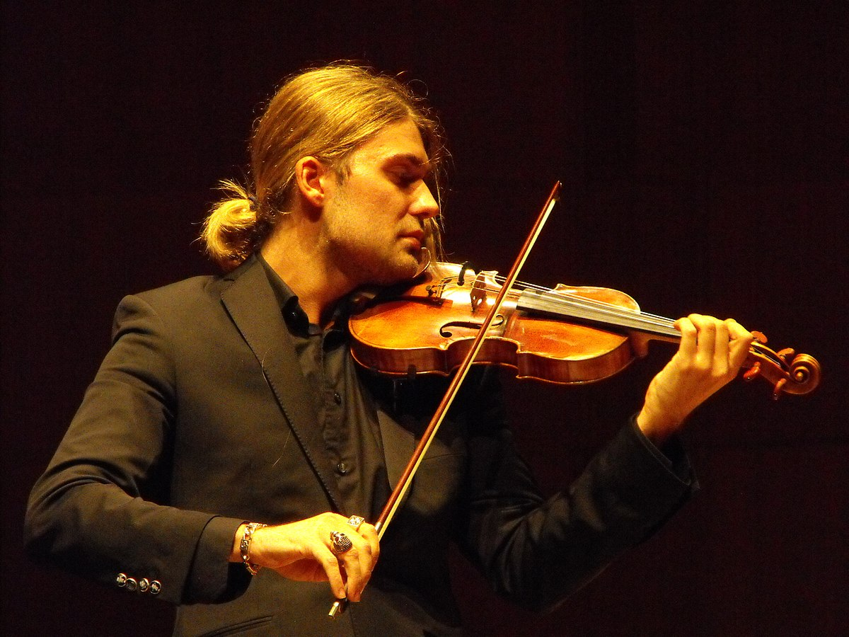
This Photo by Unknown Author is licensed under CC BY-SA
This Photo by Unknown Author is licensed under CC BY-SA
This Photo by Unknown Author is licensed under CC BY-SA
This Photo by Unknown Author is licensed under CC BY-NC-ND
This Photo by Unknown Author is licensed under CC BY-SA
This Photo by Unknown Author is licensed under CC BY-SA

Slide 3
دارو ساز
شخصی که اجازه تهیه و پخش و تحویل داروهای طبی را دارد و در داروخانه یا بیمارستان کار می کند .
This Photo by Unknown Author is licensed under CC BY-SA

Slide 4
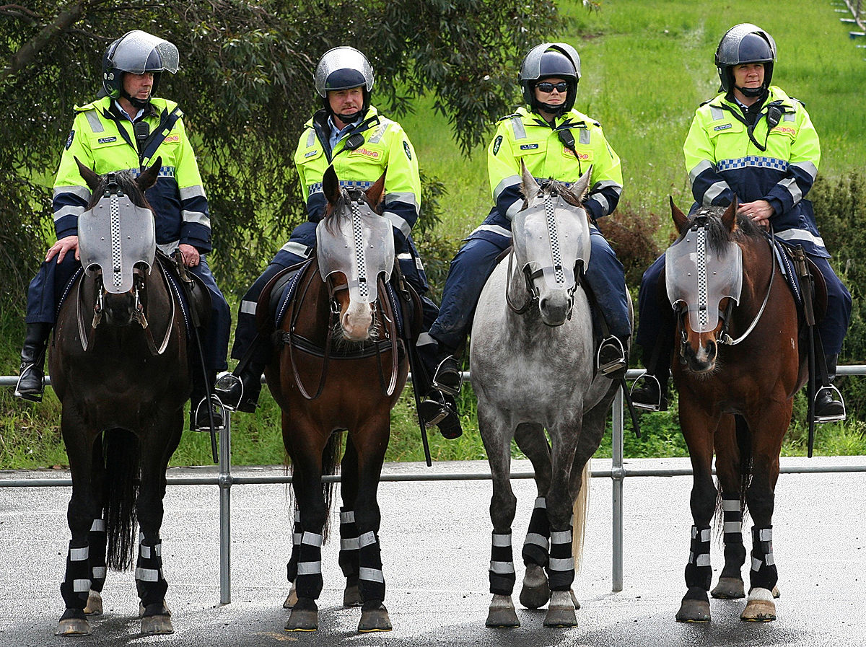
پلیس
کسی که از انجام دادن جرم جلوگیری می کند وقانون را اجرا میکند.
This Photo by Unknown Author is licensed under CC BY-SA
This Photo by Unknown Author is licensed under CC BY-NC-ND
This Photo by Unknown Author is licensed under CC BY-SA-NC

Slide 5
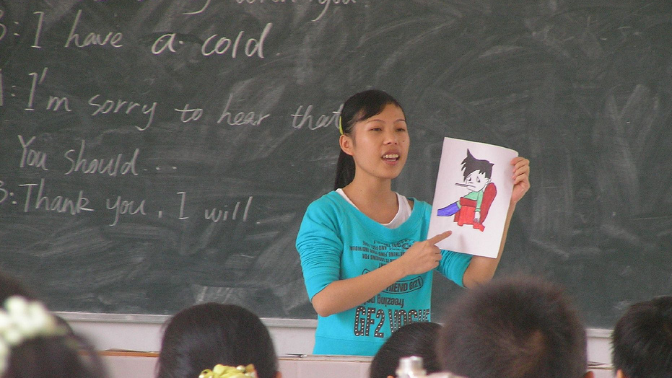
آموزگار
کسی که شغل او تدریس به دیگران به خصوص دانش آموزان مدرسه است
This Photo by Unknown Author is licensed under CC BY-SA

